Slide 1
Creating Effective
Racial Change
in America by
Implementing
Police Reform
Carla Manns
Ethnic & Diversity Studies

Slide 2
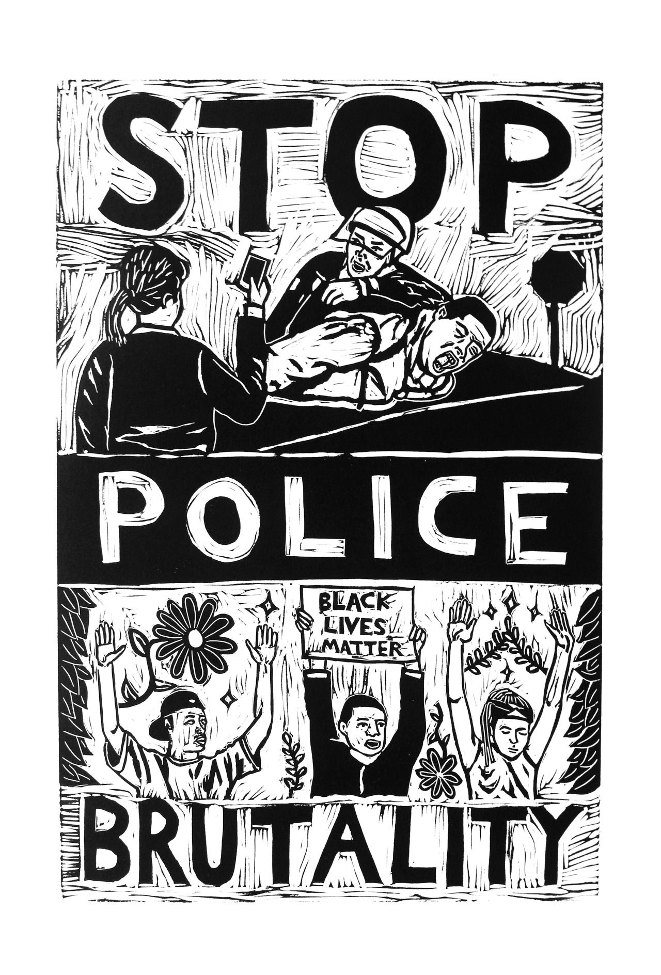
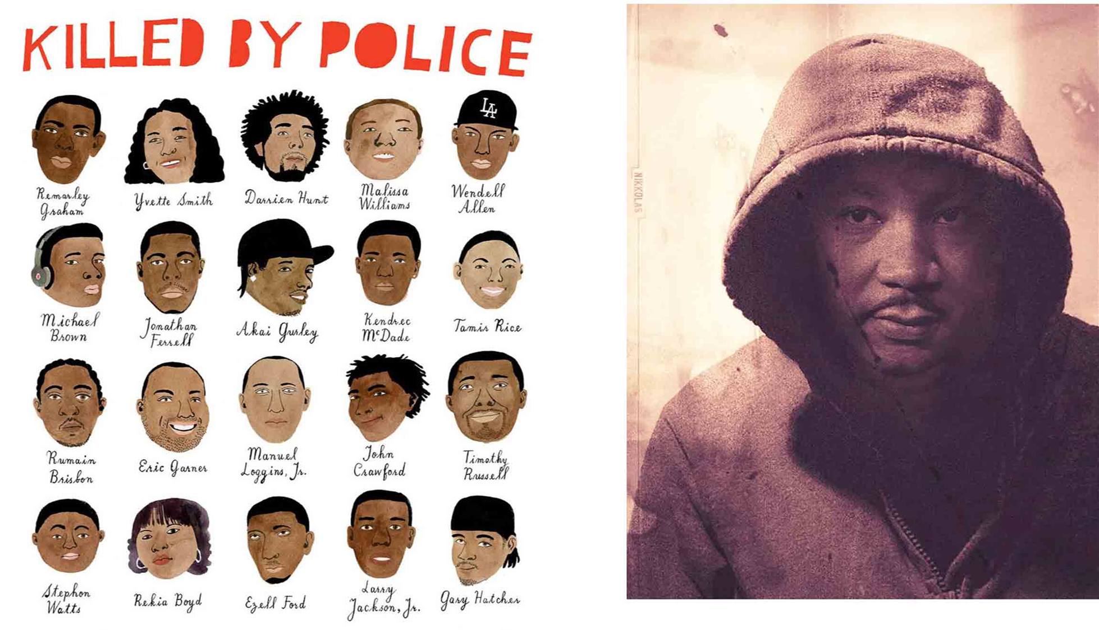
Policing started as slave patrols in Philadelphia in 1751
“It’s a story that’s been going on for centuries in the US. After the founding of the country, police enforced explicitly racist laws on slavery and segregation.
“African Americans trust the police half the rate as their white counterparts.”
“Black communities are less safe, crimes are less policed, the police are more violent in black neighborhoods.”
Half the People Killed by Police Have a Disability

Slide 3
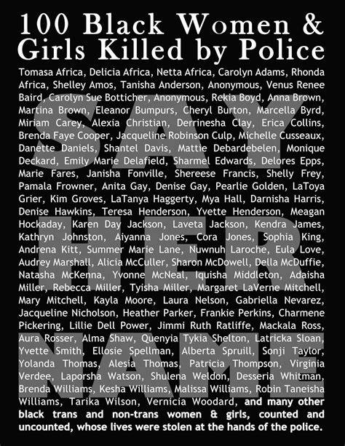
Black women are killed by police too!
Did you know?

Slide 4
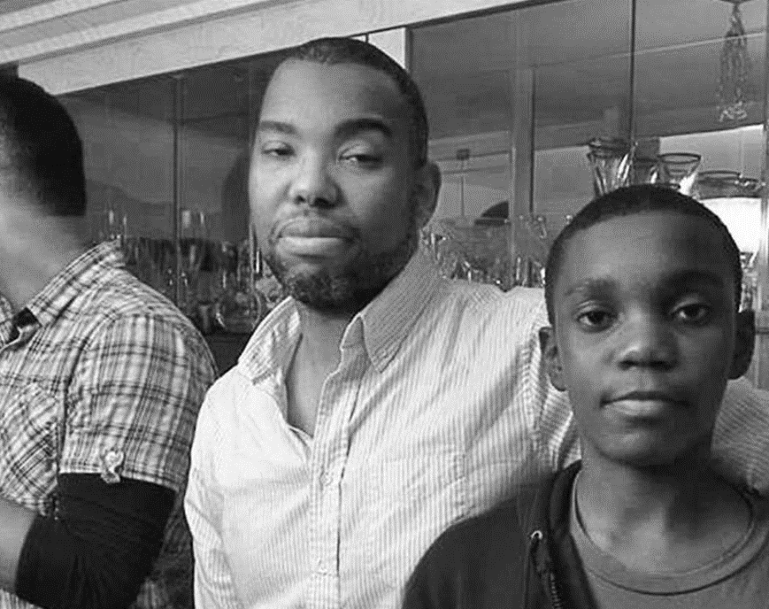
“All you need to understand is that the officer carries with him the power of the American state and the weight of an American legacy, and they necessitate that of the bodies destroyed every year, some wild and disproportionate member of them will be black.
Letter to My Son, Ta-Nehisi Coates

Slide 5
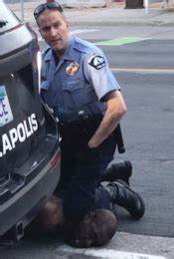
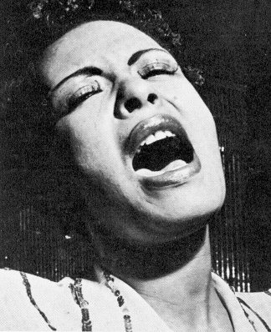
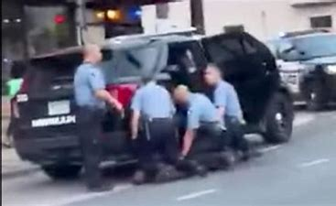
When I hear the song being sung by Billie Holiday and see the killing if an unarmed black man the two exist in my mind simultaneously. The same tragedy is seen right before us and justice is still at its infancy in the mind of many Americans. Modern day lynching in the face of all to see but instead of blood at the roots they flow in the streets of our cities. Instead of smelling burning flesh nightmares circle my mind wondering who will be next and who will be set free.

Slide 6
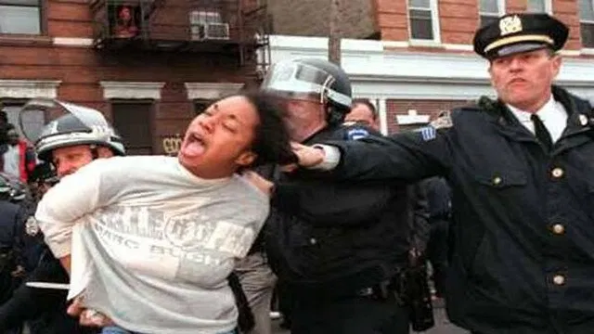
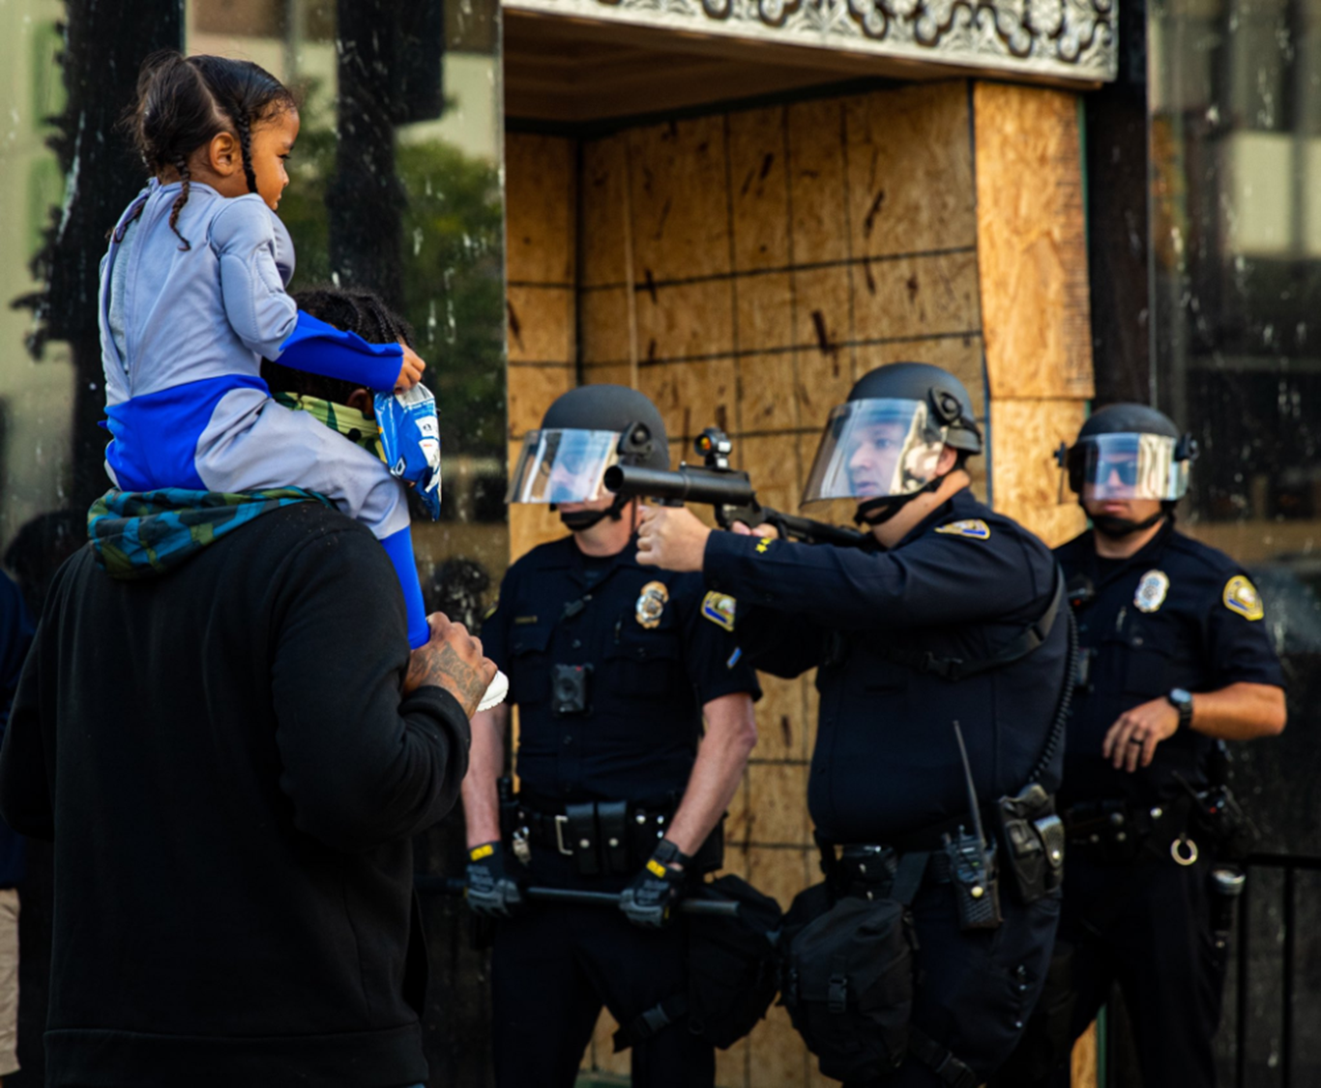
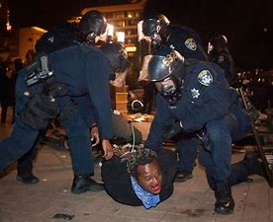
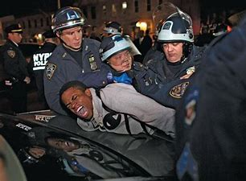
We need police reform now!
Is this your sister, mother, child or friend. She is a person!
Do you really have the right to protest?
A child has a gun pointed at her father’s
face while she is on his shoulders

Slide 7
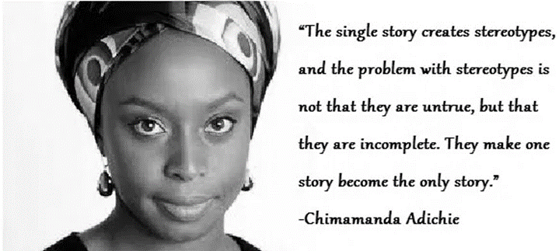
It can’t be a Single Story
About the relationship between the Police and African Americans in the US
The single story is that all police want to kill or destroy black people.
The single story is that black men and women are loosing their opportunity to have a fair day in court because police are killing them before they can be seen by a judge.
The single story is that as a culture, we can’t do anything about the story that will be written by someone else because they hold the pen of justice.
The single story is my children and your children will see the police differently because of how they are policed based on the color of their skin.
These stories are damaging and destructive unless we rewrite them with Police Reform.

Slide 8
How can we reform the police?

Slide 9
Step 1
Defund the police means reallocating or redirecting some funding away from the police department or other government agencies funded by the local municipality. The funds would go toward community programs;
* 13 US Cities have defunded their Police Departments
Social Programs
Violence Prevention
Mental Health
Homelessness
Education Services

Slide 10
Step 2
All Police Departments should require additional hours for
Crisis Intervention Team Program training (40hrs are required)

Slide 11
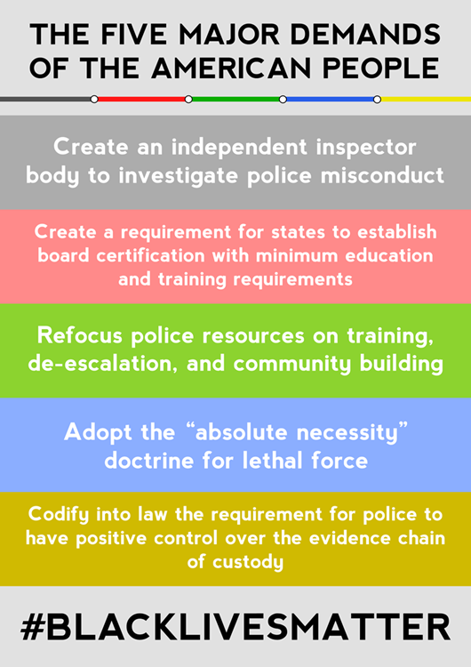
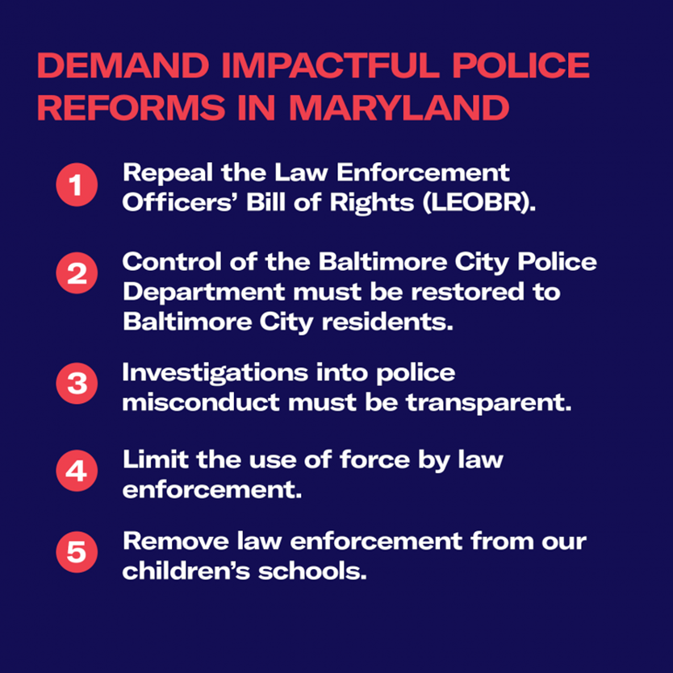
Step 3

Slide 12
What will Reforming the Police Do?

Slide 13
REFERENCES Documentary on police reform after Dontre Hamilton was shot and killed by police officer: https://vimeo.com/188310685?ref=fb-share&fbclid=IwAR2qxqfLk5pvwPZ9vsu6uVeapWOVHGP8QLLnoGuWNXY7Cdk8PoImD4lQIs8 (Links to an external site.) What Does Defund the Police Mean? And Does it Have Merit? https://www.brookings.edu/blog/fixgov/2020/06/19/what-does-defund-the-police-mean-and-does-it-have-merit/ (Links to an external site.) "How to Reform American Police": https://www.vox.com/2020/6/1/21277013/police-reform-policies-systemic-racism-george-floyd?fbclid=IwAR1Ts3hBzv6dHl3s1I5Ma41gQOiL_ETGqaMLpSlCE27jwWrC2h4Eu2xhOvQ Ta-Ne Hisi Coates’s “Letter to My Son” https://www.theatlantic.com/politics/archive/2015/07/tanehisi-coates-between-the-world-and-me/397619/ https://www.washingtonpost.com/news/arts-and-entertainment/wp/2016/07/13/the-most-powerful-art-from-the-blacklivesmatter-movement-three-years-in/?utm_term=.b4164cbff839 Chimamanda Adichie’s TED talk “The Danger of a Single Story.” https://www.ted.com/talks/chimamanda_adichie_the_danger_of_a_single_story?language=en NPR radio story: Strange Fruit: Anniversary of Lynching: https://www.npr.org/templates/story/story.php?storyId=129025516

